Slide 1

An online SHOPPING website project
by group 2
Danna Pauline Soquiat
Kassandra Ysabel Fuentes
Lance jasper lopez
Meynard denoyo
William Kalingasan
Ziegfreid morissey flameÑo

Slide 2
Background
Watch Me Whip is an online watch shop that features:
Register/Login/Logout
Add/Edit/Remove Product From Cart
Save Cart Upon Logging Out
Mark Products As Favorites
Apply For Premium Account
Apply Premium Code Upon Registering
Update Customer Information
User Count
Admin Account

Slide 3
Limitations
No favorite items list (only indicator in UI)
Order history does not contain product information
No admin UI for blacklisting users
No validation if premium code is valid
No dedicated DB table for premium codes (only placed in config file)

Slide 4
Distribution of Tasks
General Distribution:
Client-Side Development
Ziggy
William (Partial)
Kass (Partial)
Server-Side Development
Lance
Danna
Meynard
William (Partial)
Kass (Partial)
Testing
First Verifier: Kass
Second Verifier: Ziggy

Slide 5
Distribution of Tasks
Detailed Distribution
Ziggy
Distribution of tasks
Most of the UI Enhancements (Except Account Information & User Request Pages)
JMS
William
Checkout Logic
Blacklist Filter
Favorite Items Logic
Premium Register Logic
DB Architecture Changes (+ ERD)
UI: User Request Page, Registration logic (Assisted)

Slide 6
Distribution of Tasks
Lance
Migration of DAO classes from Hibernate to Eclipselink
Service layer/classes
Abstract class/Generic DAO
Meynard
Controllers: AddtoCart, CartProduct, Login, Order, OrderProducts, Products, Register, User
CartProductDAOImpl, CartProductSVCImpl
Password Hashing

Slide 7
Distribution of Tasks
Danna
User model, DAO, DAOImpl
User Count Listener
User Count Controller
Request DAO, DAOImpl, SVC, SVCImpl, Controller
UML
Gantt Chart
Kass
Account Controller
Edit Register Controller
Spring Validator
Junit

Slide 8
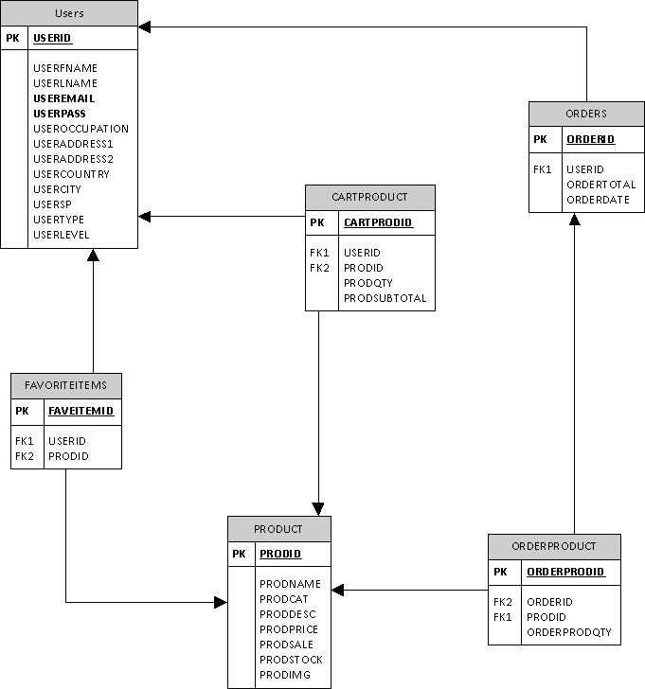
Entity Relationship Diagram
Ideal Diagram

Slide 9
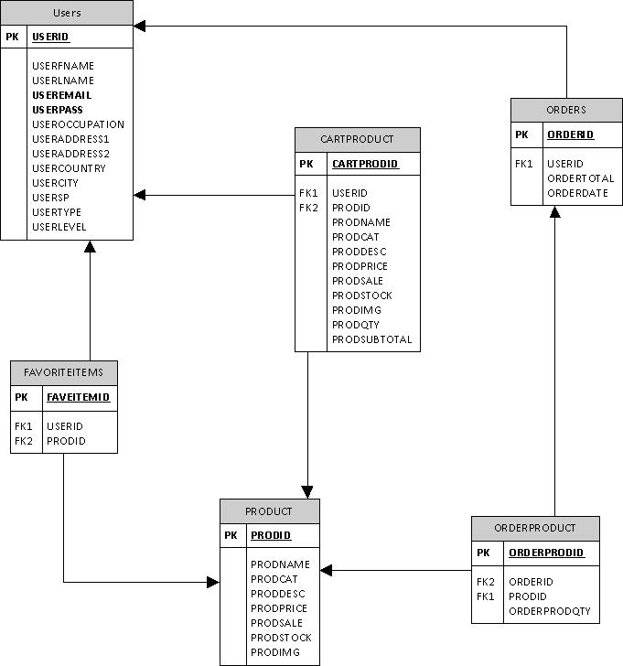
Entity Relationship Diagram
Actual Diagram

Slide 10
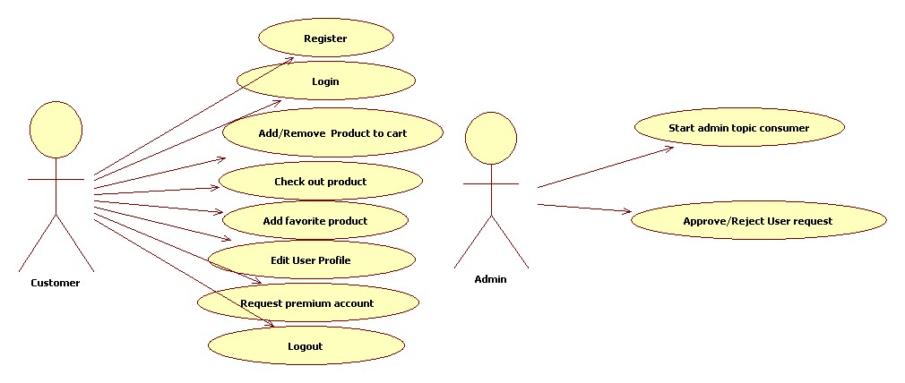
UML Diagram

Slide 11
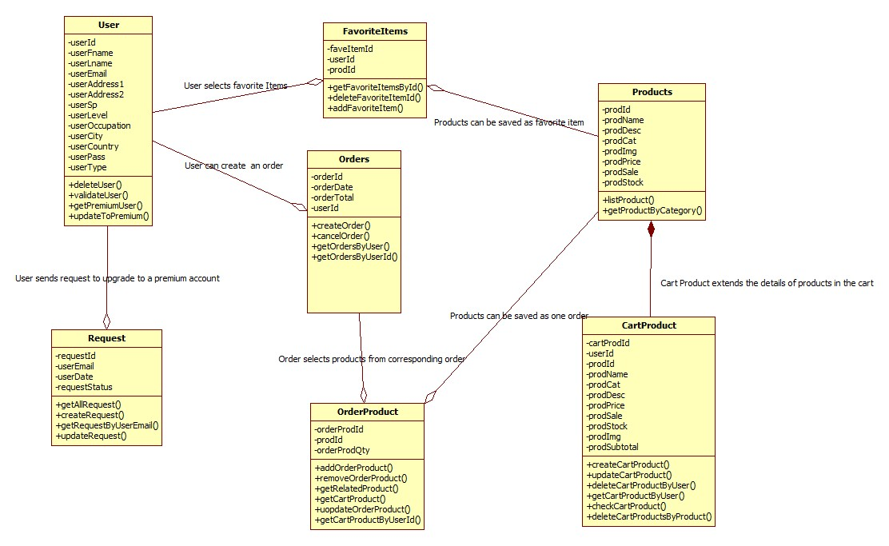
UML Diagram

Slide 12
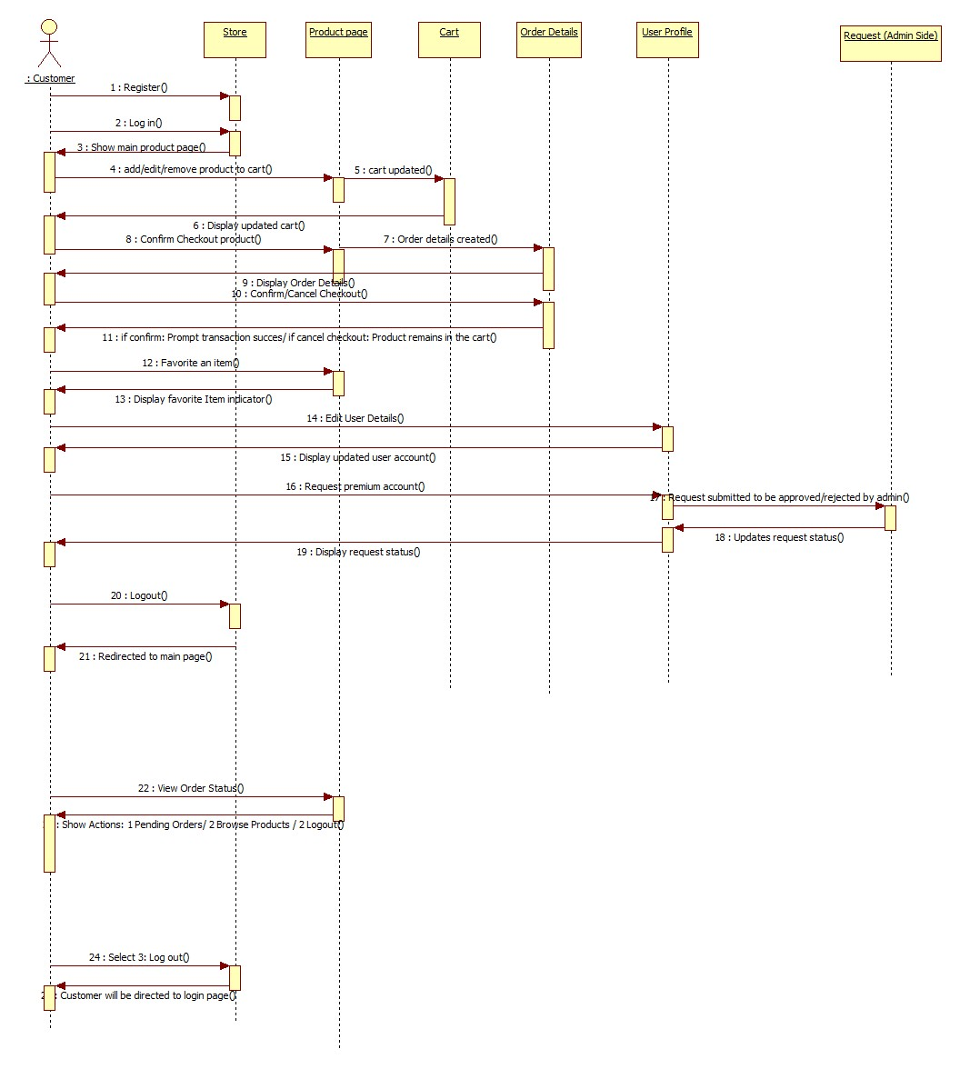
UML Diagram
Sequence Diagram

Slide 13
Detailed Functions Per User
Customer
Register/Login/Logout
Browse products
Add to Cart
Edit cart
Remove product from cart
Add to favorite
Apply premium
Admin
Start Admin Topic consumer
Approve Customer premium requests

Slide 14
Concepts Applied:
Filters/Listeners
Object Relational Mapping
JMS
REST
AJAX
JPA
JPQL
Password Hash
Spring Validator
Spring MVC
Log4J
ExtJS
GenericDAO

